Slide 1
Evaluating Progress in Disaster Preparedness across Countries: Hyogo concepts Made Easy (and Influential)
Dale Hill, Sr. M & E Advisor,
American Red Cross International
September 1, 2011
1

Slide 2
Purpose of Workshop: For You
To Illustrate 4 ways to increase influence
Use of consensus framework (Hyogo)—techn. credibility
Use of simple data collection instruments—flexible for context, but uniform in analysis—accept. to communities
Weighting and indexation to enable:
Comparison across countries, communities
Summary presentation of understandable concepts
Appealing visuals for both community & technical audience to:
Set priorities
Celebrate progress

Slide 3
Purpose of Workshop– for Us
Framework & Methodology is still under development
Tested baseline and mid-term tools in several countries
Trained national RC societies in Latin America and Caribbean to get feedback
Still to come: simulations; endlines & analysis
Thus, we welcome YOUR input at this stage

Slide 4
Acronyms
RC = Red Cross or Red Crescent
NS = National (RC) Societies in-country
DRR = Disaster Risk Reduction
CBDRR = Community Based Disaster Risk Reduction
VCA = Vulnerability & Capacity Assessment
(a standard part of CBDRR approach of RC)
JHU = Johns Hopkins University (United States)

Slide 5
Red Cross CBDRR Programs in Latin America and the Caribbean
Aim to increase disaster preparedness and resiliency in vulnerable communities
Urban and rural
Several communities per country
At least 11 countries will participate in CBDRR programs
Funded under two separate grants
Similar objectives and program activities in each region
Two to three year programs, depending on the country location
Caribbean
Antigua & Barbuda
Bahamas
St Kitts & Nevis
St Lucia
LAC CBDRR Program Countries
Central America
El Salvador
Honduras
Panama
South America
Colombia
Ecuador
Paraguay
Peru

Slide 6
Joint Effort with Johns Hopkins University: Opportunity
Wanted methodology to help us learn about CBDRR program outcomes at a regional level
Few quantitative evaluations of CBDRR completed to date-- so Red Cross & JHU have opportunity to contribute greatly to the field
Acknowledge technical input of Shannon Doocy, Professor at Johns Hopkins University

Slide 8
Monitoring and Evaluation Objectives
Standardize CBDRR monitoring and evaluation across program countries
Summarize results across multiple settings
Compare communities and programs across the region:
Identify settings where CBDRR works best
Identify which types of CBDRR activities are most effective

Slide 9
The Theoretical Basis for Red Cross CBDRR Programs
CBDRR Programs are informed by the Hyogo Framework in Disaster Risk Reduction
The evaluation strategy includes:
Baseline and final evaluations
Routine monitoring of community CBDRR activities
Each individual monitoring tool is designed to measure aspects of the 5 domains of resilience of Hyogo Framework

Slide 10
Overview of CBDRR activities, outcomes, and M&E framework

Slide 11
Overview of the Monitoring and Evaluation Strategy
Project monitoring activities:
Aim to minimize the reporting burden for Red Cross National Societies
Represent a minimum standard;
NSs may collect additional information or add questions that are specific to the local context
Resilience assessed by combining data from a household survey, focus groups with community leaders, and a community observation checklist.
Also-Post-disaster assessments to capture response
to actual disaster.

Slide 12
Overview of Monitoring and Evaluation Activities
Project Beginning
(1st 6 months)
Project Activities Ongoing in Communities
(~15-27 months with monitoring every 2-4 monts)
Project End
(last 3 months)
Baseline Assessment
Routine Monitoring
Community visits every 6 months
Final Assessment
Survey of 100 households
Two focus groups
Community Checklist
Two focus groups
Community checklists
Survey of 100 households
Two focus groups
Community Checklist

Slide 13
Visualizing the Resiliency Domains

Slide 14
Key Components of the Resiliency Domains
Governance:
Policy, planning, and political commitment of local governments and community structures
Partnerships and accountability between government and community groups/actors
Risk Knowledge:
Perceptions, awareness and assessment of past and current hazards
Vulnerability and capacity assessment
Public Awareness:
Knowledge development, including education and training
Community participation, commitment, and action
Information management and sharing
Risk Reduction:
Community level environmental risk reduction measures (including micro-projects)
Vulnerability reduction (including sustainable livelihoods, social protection measures)
Preparedness:
Household and community preparedness measures and response capacities
Early warning systems
Organizational response capacities and coordination

Slide 15
The Household Survey Monitoring tools - Focus Groups - The community checklist - the post-disaster report

Slide 16
Key Components of the Household Survey
Contact community leaders
Identify and train the interviewers
Adapt the questionnaire to the local context
Obtain community maps and plan the sample
Conduct the baseline/final assessment
Household survey
Focus groups with community leaders
Summarize results

Slide 17
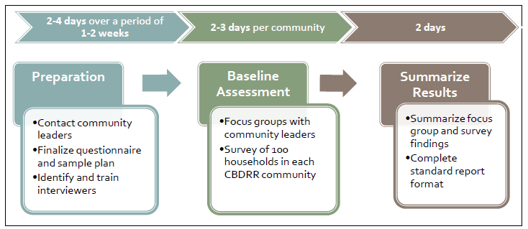
Baseline/Final Evaluation Timeline
Should be feasible to implement at the national level in a two to three week period
Dependent on the number of communities participating in CBDRR programs
Accessibility of selected communities

Slide 18
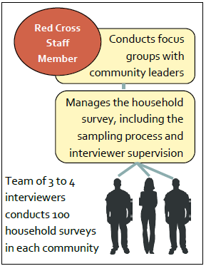
The Survey Team
Apart from National Society staff serving as supervisors, a team of 3-4 interviewers is required
Ideally the same interviewers are used in all communities
Training is required only once
Survey is implemented in a consistent manner
Interviewers should not be from CBDRR communities

Slide 19
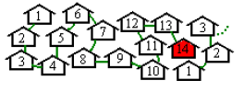
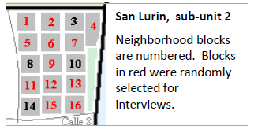
Sampling Methods Two Options
Interval sampling
Total number of households in the community is estimated. Every nth household is selected
Works best in smaller rural communities
Segmentation sampling
Random select of sub-areas and then households within the community
Works best in urban areas

Slide 20
Household Questionnaire Content and Analysis
Content Areas
Household characteristics
Disaster Risk Knowledge
Hazards exposure
Household preparedness
Community preparedness
Public Awareness
Governance
Analysis: tally sheets for responses with totals entered into an excel file

Slide 21
The Household Survey Monitoring tools - Focus Groups - The community checklist - the post-disaster report

Slide 22
Types of Focus Groups
2 focus groups conducted in each community:
Community Leaders -- elected officials, teachers, priests, leaders of community groups, elders, and others who hold formal or informal leadership roles.
Aim is to gain a broader perspective
People with Exceptional Disaster Knowledge-- individuals responsible for community disaster response or planning, people who have been involved in disaster-related trainings/projects, & key counterparts for CBDRR project.
Aims is gain a detail understanding of risk reduction activities

Slide 23
Focus Group Overview
Measures collective knowledge, attitudes & activities around DRR in community
Completed in baseline and final evaluations and every 6 months for monitoring
Two focus groups conducted per community on each monitoring visit
Approximately 2 hours in duration

Slide 24
The Household Survey Monitoring tools - Focus Groups - The community checklist - the post-disaster report

Slide 25
The Community Checklist
--Completed in the baseline and final assessments
and every 6 months during monitoring visits
--Community ‘walkabout” or tour with 1-2 key informants
--Reports observations later verified by viewing documents & key community sites & DRR projects
--Requires 1 hour or less to complete

Slide 26
The Household Survey Monitoring tools - Focus Groups - The community checklist - the post-disaster report

Slide 27
The Post-Disaster Report
Final question in Community Observation Checklist asks if disaster or hazard occurred in past 6 months
If answer is yes, post-disaster report should be completed
Includes disasters that affected community + hazards that threatened community but led to no damage
It is important to capture community response
(early warning system or evacuation) since:
Could be direct result of CBDRR activities
Reinforces CBDRR learning—shows value
Improves readiness for next hazard or event

Slide 28
Questions/Exercise
Which of the characteristics of these methods appeal to you most for potential influence?
What parts may be potentially risky or require most careful attention in implementation?
Can you share some of your own methods (DRR or other sectors) which share some of these characteristics?
OR—can you think of ways you could adapt your existing methods to tap similar potential?

Slide 29
THE END
Thank you for your Attention
HillDal@usa.redcross.org

Slide 30
The Community Checklist
The focus group is a good way to lead into the Community Checklist component of the evaluation.
One or more of the members of the focus group of individuals with disaster knowledge is likely to be a good person to assist you with the community checklist.
If possible identify one or two people, preferably a community members involved with the Red Cross CBDRR project, as a key informant(s) for the community.
They can assist in completing the community checklist during monitoring visits, should be knowledgeable about ongoing DRR activities, and can serve as a project liasion

Slide 31
Monitoring and Evaluation Tools
Each of the individual monitoring tools is designed to measure aspects of the five domains of resilience.
Resilience will be assessed by combining data from a household survey, focus groups with community leaders, and a community observation checklist.
By measuring resilience, the evaluation aims to assess changes in risk mitigation, preparedness, and response capacity as a result of Red Cross activities.
Post-disaster assessments are an additional evaluation tool that can be used to capture a communities’ experiences in responding an actual disaster.

Slide 32
The Post-Disaster Report
It is important that all disasters that affect a community are recorded.
For this reason, it is important to ask about disaster occurrences in the community every six months during the monitoring visits.

Slide 33
Focus Group Overview
When focus groups are conducted as part of the baseline and final surveys, they should be conducted on the second or third day of the visit
When focus groups are conducted for monitoring, it should be possible to complete them in one day along with the other monitoring activities
Preparation is critical to ensure that the focus group can take place as planned.
Contact community leaders in advance
When possible, try to use the same (or similar) focus groups participants throughout the project period.

Slide 34
Overview of Monitoring and Evaluation for Each Community
Baseline and final assessments
Most time consuming components of the planned M&E because they include household surveys
Interim monitoring activities completed every six months while project is ongoing in a community
Aim to be useful project management tools
Aim to aid Red Cross NSs in evaluating CBDRR progress and understanding current community needs.

Slide 35
Community Risk Scores
The following equation is commonly used to illustrate disaster reduction concepts and to communicate elements that contribute to disaster risk levels:
Risk = Hazard x Vulnerability
Capacity
Serves as the basis for determining community risk scores

Slide 36
Domains of Resilience
Red Cross CBDRR Program Elements | Corresponding Evaluation Domains | Hyogo Framework Priority for Action
Governance | Governance | Governance
Risk Assessment | Risk Knowledge | Risk identification, assessment, and early warning
Knowledge and Education | Public Awareness | Knowledge management and education
Risk Management and Vulnerability Reduction | Risk Reduction | Reducing underlying risk factors
Preparedness | Preparedness | Preparedness

Slide 37
Community Risk Scores
Measured on a scale of 1 to 100
At baseline and final evaluations
Can be partially updated with monitoring information
Lower Risk Medium Risk Higher Risk Highest Risk
0 – 40 40 – 60 60 – 80 80 – 100

Slide 38
Measuring Resiliency
Components from each of the different tools are combined to produce scores for the different components of resiliency and risk reduction in each community.
These can be used in discussions with the community about disaster risk and to measure changes in community capacity over time.
Scores will change over the project period based on the input of new monitoring data and provide an updated perspective of community resilience and disaster risk.

Slide 39
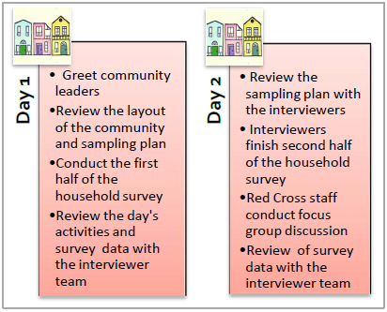
Survey Implementation Overview

Slide 40
Community Level M & E Outcomes
Qualitative understanding of ongoing activities and current needs
Performance by numerous indicators
Primarily in the baseline and final assessment
Two community-level summary measures
Resiliency Domains
Community Risk Scores

Slide 41
Household Survey Overview
Used in both the baseline and final evaluations of CBDRR programs
Provides information on communities that can aid in developing CBDRR program activities that address community needs
Measure program impact by looking at changes in pre/post program
Aims to simplify evaluation by collecting a minimal amount of information
Reduced reporting burden for National Societies
Feasible to implement and analyze in a short period
Allows for comparisons across communities and countries

Slide 42
Household Survey Overview
The only tool that measures project impact from the community’s view point
Provides a perspective beyond that of community leaders or other community members involved in the project
Every household in the community has a chance to be selected for participation
100 households are included in the baseline and final evaluations
A household interview lasts on average ~15 minutes
Households in the baseline and final surveys will be different

Slide 43
Sample Planning
A critical component of the assessment
Has the potential to impact findings
If available, community maps or household lists should be used to plan the sample in advance
Ensures a consistent sampling process where all households have a chance to be selected
Easier to coordinate interviews and manage data collection
If not available, maps can be made with the help of community members

